Slide 1
CND 121 Introduction to Silicon Process and VLSI. 4-bit Full Adder

Slide 2
AGENDA
Introduction
Blocks and gate level
Schematic
Numbers
Power Dissipation
RTL
Summary

Slide 3
INTRODUCTION
A 4-bit full adder consists of four single-bit full adders connected in series. Each single-bit full adder has three inputs (A, B, and Cin) and two outputs (Sum and Cout).
Each single-bit full adder computes the sum (S) and carry out (Cout) based on the inputs A, B, and the carry in (Cin). The carry out (Cout) of each full adder becomes the carry in (Cin) for the next full adder. The final sum bits are represented by Sum3, Sum2, Sum1, Sum0, and the final carry out is Cout.​

Slide 4
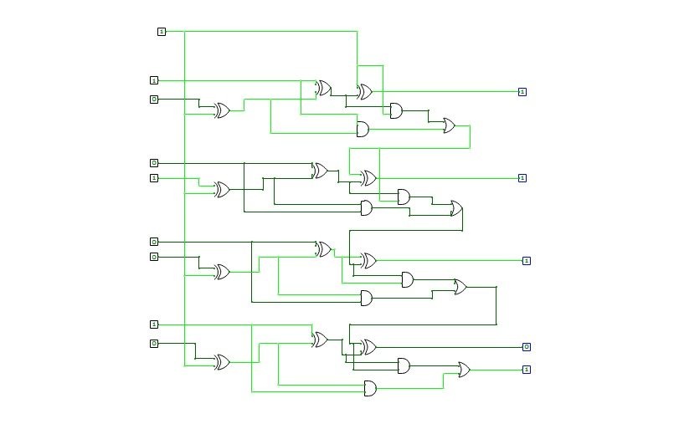
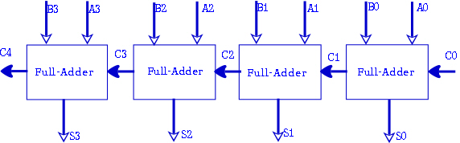
Blocks and gate level
gate level
Blocks

Slide 5
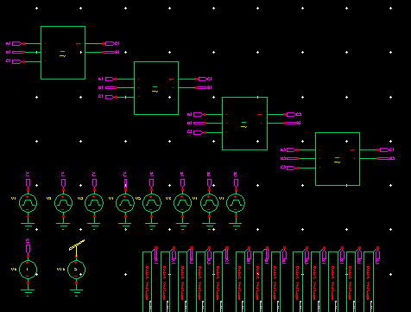
OUR final blocks
We used four blocks of full adder which we did it as a symbol and used square wave source as an inputs from library of sources
And used commend plot to see the outputs

Slide 6
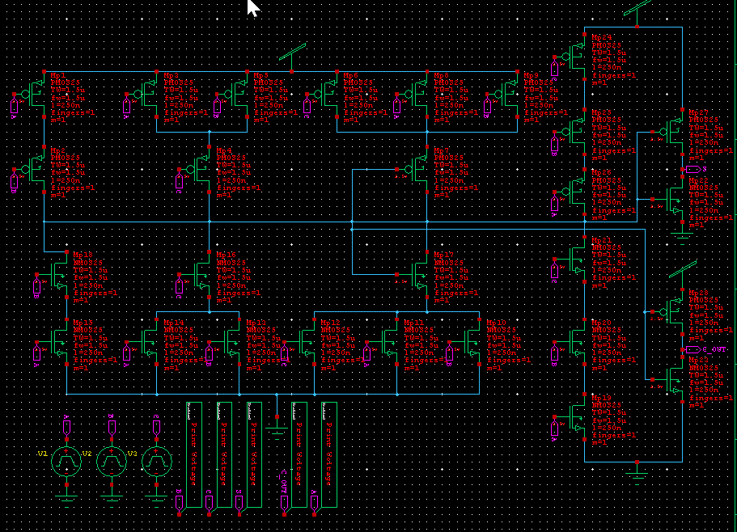
Transistor level.
Schematic of 1-bit full adder we created a symbol and used it 4 times

Slide 7
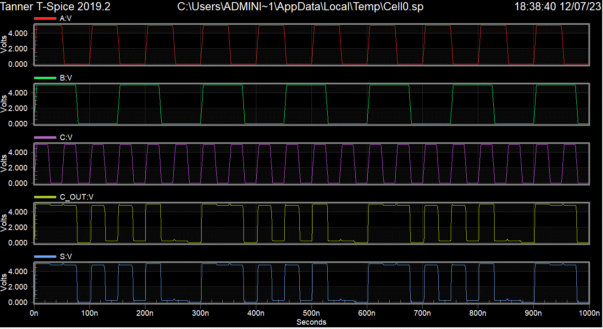
The wave form.
The inputs a,b and c a square wave sources with different period

Slide 8
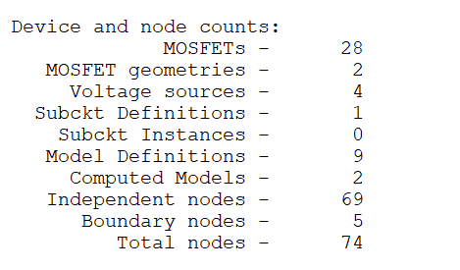
Some numbers for only one block.

Slide 9
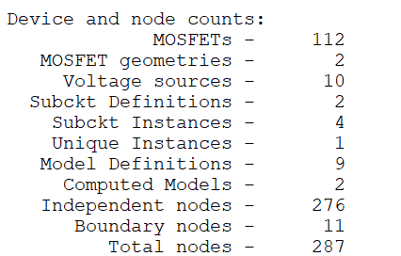
Numbers from all the system.

Slide 10
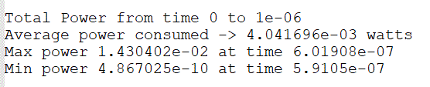
Power Dissipation (one block)

Slide 11
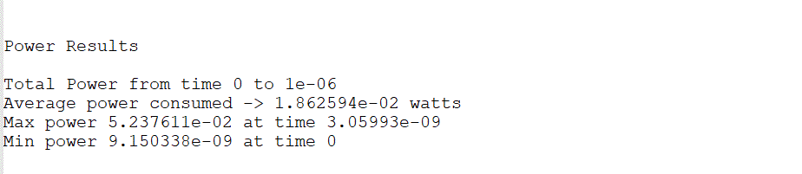
Power Dissipation (all the system)

Slide 12
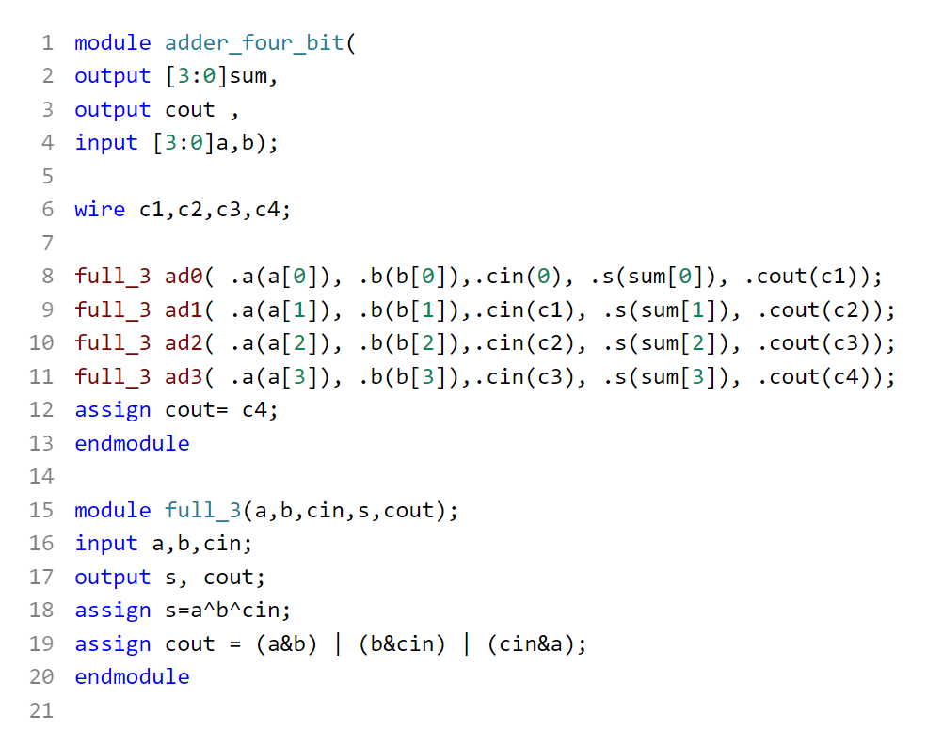
VERILOG CODE

Slide 13
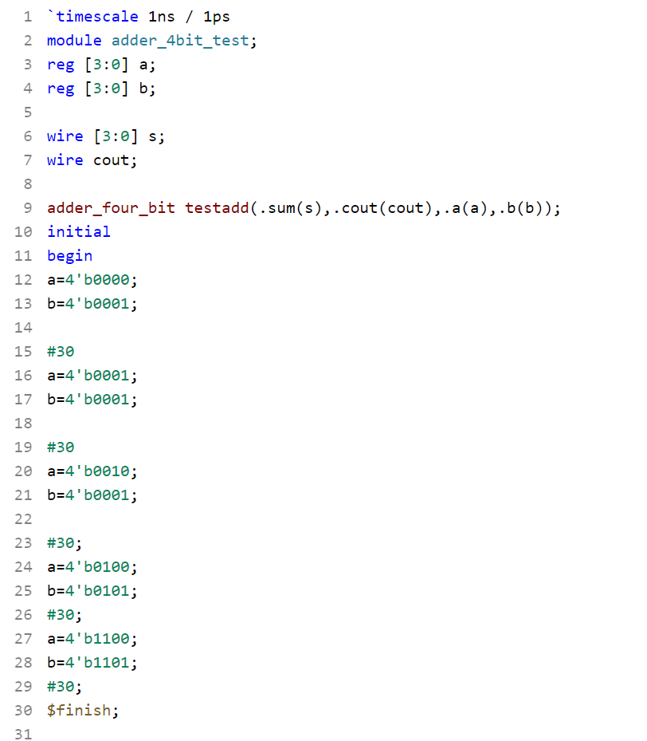
Test Bench.

Slide 14
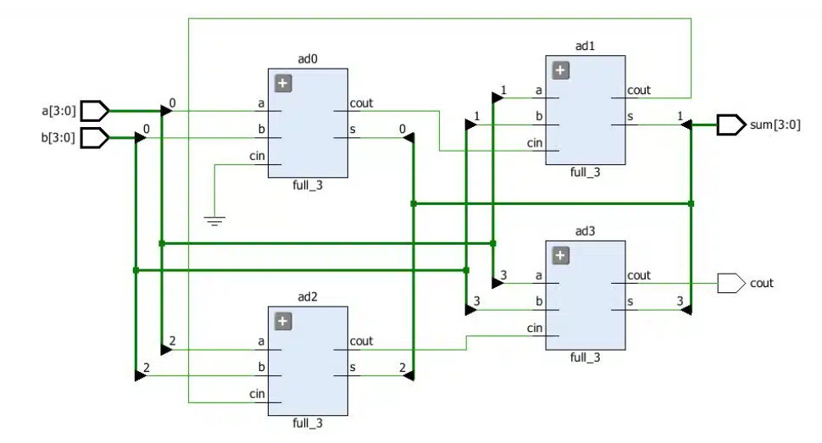
RTL Schematic Output

Slide 15
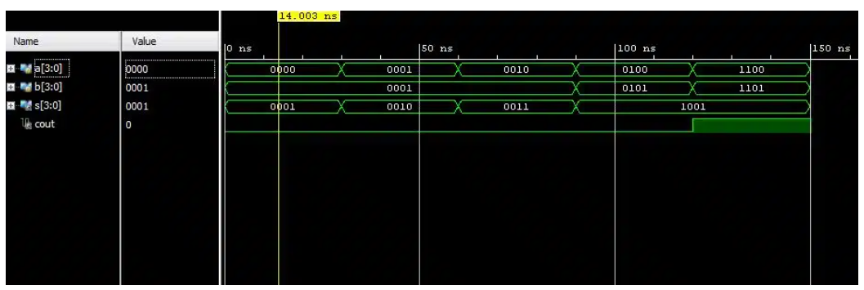
Output of the Test Bench simulation

Slide 16
MEET OUR TEAM
AHMED SALAH
Ismail Mohamed
MOHAMED YOUSEF
Omar Hussein

Slide 17
THANK YOU

